Slide 1
Theory of Computation
Lecture 6
Practice and Closure Operations
Dr. Samar Hesham
Department of Computer Science
Faculty of Computers and AI
Cairo University
Egypt

Slide 2
Syllabus and Terminologies
Regular Languages .. Regular Sets
REs (Regular Expressions)
FSMs (or FSA/FA) … Finite State Machines/Automata
DFA vs. NFA … Deterministic vs. Non-deterministic FSA
Comparison and Conversion
Examples & Closure Operations
Pumping Lemma
Context Free Languages
CFGs … Context Free Grammars
PDA … Push Down Automata
Parsing: CFG generating strings vs. PDA recognizing strings
Turing Machine

Slide 3
Practical Examples & Closure Operations
3

Slide 4

FSA accepting strings divisible by 4
Forming a RE for binary strings divisible by 4 is not straight-forward.
Thus, we should think how to algorithmically detect strings divisible by 4.
Just like checking whether a decimal number is divisible by 100 … ends with 2 zeros.
Check whether a binary number ends with 2 zeros:
4 = 100 = 2²

Slide 5
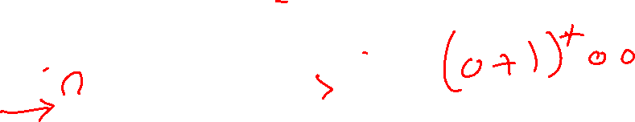
FSA accepting strings divisible by 4
This can be easily done by directly designing a FA that accept the binary strings divisible by 4.
Final state should also be a start state. Why?

Slide 6
FSA accepting strings not divisible by 3
We should know how to detect binary strings that are not divisible by 3.
Any ideas?

Slide 7
Closure Properties of Regular Languages

Slide 8

Regular Expression and FA
Primitive Regular Expressions:
regular
languages
a

Slide 9

Regular languages are closed under:
Namely, for regular languages and :
Union
Complement
Intersection
Normal Set Operations
Regular
Languages
Closure: The resulting Language is still Regular

Slide 10

Regular languages are closed under: (Cont’d)
Namely, for regular languages and :
Concatenation
Reverse
Star operation
Regular
Languages
Closure: The resulting Language is still Regular

Slide 11
Complement
Theorem:
For regular language
the complement is regular
Proof:
Take DFA that accepts and make
nonfinal states → final states
final states → nonfinal states
The resulting DFA accepts

Slide 12

Only DFA can be complemented
Toggling the states of NFA doesn't complement the set of accepted strings
It might unexpectedly accept any string !
So, to correctly complement a given NFA:
Convert that NFA to DFA,
Complement this DFA, then
Convert the complemented DFA into NFA

Slide 13
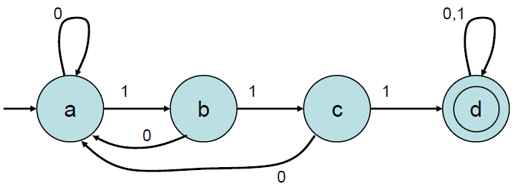

Example of complementing a DFA
Example: FA for { w | w does not contain 111 }
– Start with FA for { w | w contains 111 }:

Slide 14
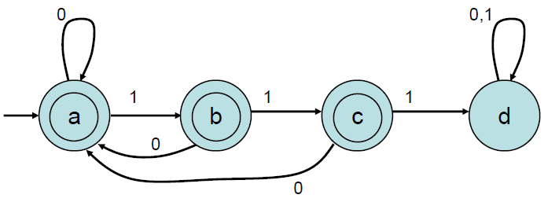
Example of complementing a DFA
Example: FA for { w | w does not contain 111 }
– Interchange accepting and non-accepting states:

Slide 15

Another Example:

Slide 16




Back ! FSA accepting strings not divisible by 3
Firstly, we can try designing a FA that detects strings divisible by 3.
After that, we can complement this FA.

Slide 17
Intersection
Theorem:
For regular languages and
the intersection is regular
Proof:
Apply DeMorgan’s Law:

Slide 18
regular
regular
regular
regular
regular

Slide 19

Intersection Technique
– Start with FAs M1and M2 for the same alphabet Σ.
–Get another FA, M3, with L(M3) = L(M1) ∩L(M2).
–Idea: Run M1and M2 “in parallel”on the same input. If both reach accepting states, accept.

Slide 20
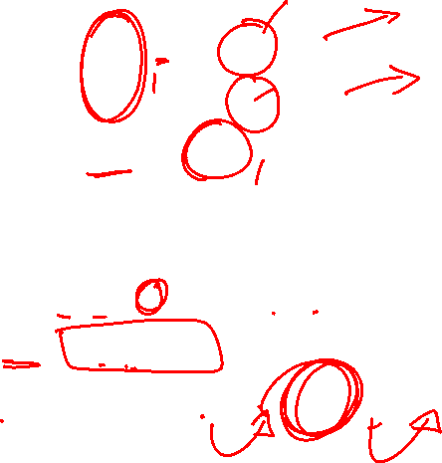
Intersection using DFA
Assume:
M₁ = ( Q¹, Σ, δ₁, q₀₁, F₁ )
M₂ = ( Q₂, Σ, δ₂, q₀₂, F₂ )
Define M₃ = ( Q₃, Σ, δ₃, q₀₃, F₃ ), where
Q3 = Q1 × Q2
Cartesian product, {(q¹,q²) | q¹∈Q¹ and q²∈Q² }
δ₃ ((q₁,q₂), a) = (δ₁(q₁, a), δ₂(q₂, a))
q₀₃ = (q₀₁, q₀₂)
F₃ ={ (q₁,q₂) | q₁ ∈ F₁ and q₂ ∈ F₂ }

Slide 21

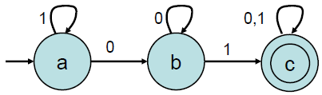
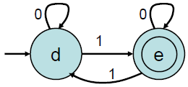

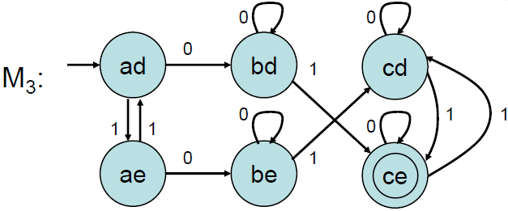

Intersection Example

Slide 22
Union
Union can be done over NFA or DFA !

Slide 23
Union
NFA for

Slide 24
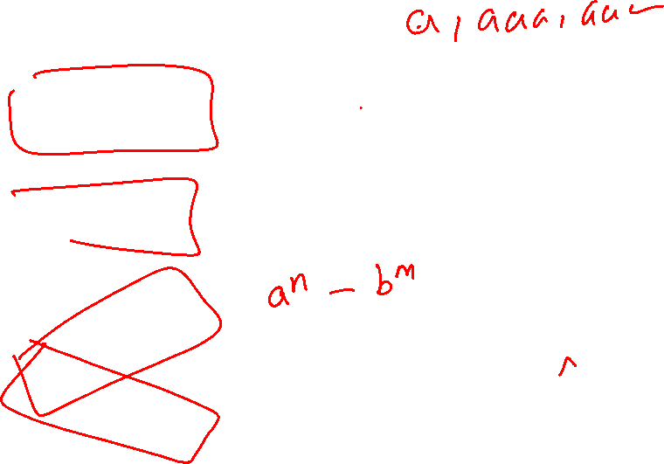
Incorrect Union
A = {a^{n} | n is odd}
B = {b^{m} | m is odd}
A ∪ B ?
No: this NFA accepts aab

Slide 25

Correct Union
A = {a^{n} | n is odd}
B = {b^{m} | m is odd}
a
λ
a
A ∪ B
b
λ
b

Slide 26
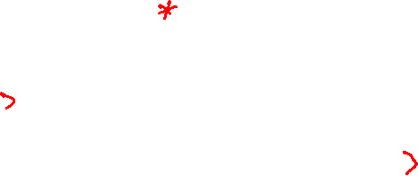
Another Example
NFA for

Slide 27

Union Technique
– Start with FAs M1and M2 for the same alphabet Σ.
–Get another FA, M3, with L(M3) = L(M1) ∪ L(M2).
–Idea: Run M1and M2 “in parallel” on the same input. If either reaches an accepting states, accept.

Slide 28
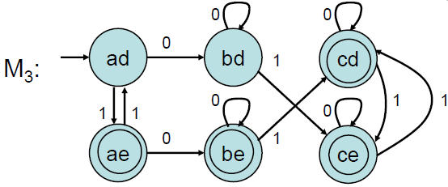
Union using DFA
Union can be done over NFA or DFA !

Slide 29

Union using DFA
Assume:
M₁ = ( Q¹, Σ, δ₁, q₀₁, F₁ )
M₂ = ( Q₂, Σ, δ₂, q₀₂, F₂ )
Define M₃ = ( Q₃, Σ, δ₃, q₀₃, F₃ ), where
Q3 = Q1 × Q2
Cartesian product, {(q¹,q²) | q¹∈Q¹ and q²∈Q² }
δ₃ ((q₁,q₂), a) = (δ₁(q₁, a), δ₂(q₂, a))
q₀₃ = (q₀₁, q₀₂)
F₃ ={ (q₁,q₂) | q₁ ∈ F₁ or q₂ ∈ F₂ }

Slide 30
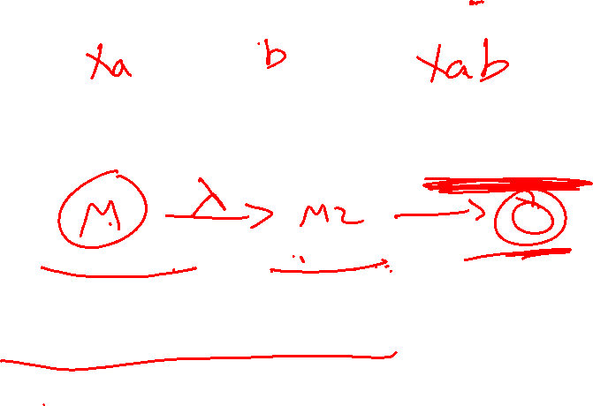
Concatenation What is it?
L₁.L₂ = { x y | x ∈ L₁and y ∈ L₂ }
Pick one string from each language and merge them.
Example:
Σ= { 0, 1 }, L₁= { 0, 00 }, L₂ = { 01, 001 }
L₁.L₂ = { 001, 0001, 00001 }
L₂.L₂ = { 0101, 01001, 00101, 001001 }
Example: ∅.L
{ x y | x ∈ ∅ and y ∈ L} = ∅
Example: {ε}.L
{ x y | x ∈ {ε} and y ∈ L} = L

Slide 31
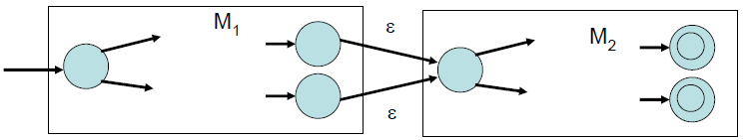
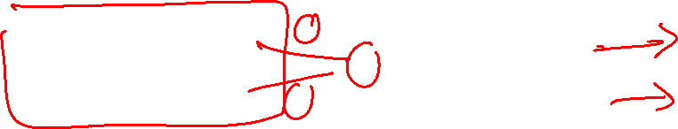
Concatenation
NFA for
Or more generally:

Slide 32

Example

Slide 33
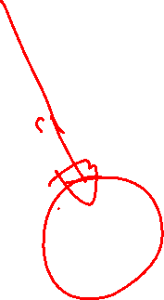
Example
NFA for

Slide 34
Incorrect Concatenation
A = {a^{n} | n is odd}
B = {b^{m} | m is odd}
{xy | x ∈ A and y ∈ B} ?
No: this NFA accepts abbaab

Slide 35
Correct Concatenation
A = {a^{n} | n is odd}
B = {b^{m} | m is odd}
a
b
a
b
{xy | x ∈ A and y ∈ B}

Slide 36

Star Operation
NFA for

Slide 37
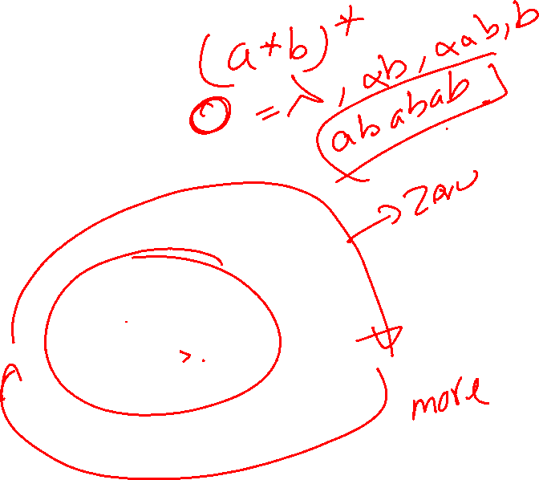
Example
NFA for

Slide 38
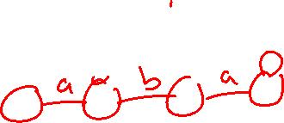
Example: 2 languages
Words that begin and end with the same letter. a(a+b)*a + b(a+b)*b
a,b
a
a
b
b
a,b
a,b
a,b
aba
Words that contain aba.
(a+b)*aba(a+b)*

Slide 39
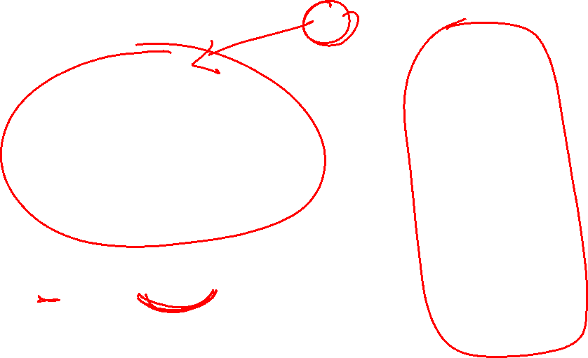
Example: Union of the 2 languages
a
b
a,b
a,b
a,b
aba
a
b
a,b
(a+b)*aba(a+b)* + a(a+b)*a + b(a+b)*b

Slide 40

Example: Concatenation of the 2 languages
a,b
a,b
a,b
aba
a
2
a
1
b
b
a,b
(a(a+b)*a + b(a+b)*b)((a+b)*aba(a+b)*)

Slide 41
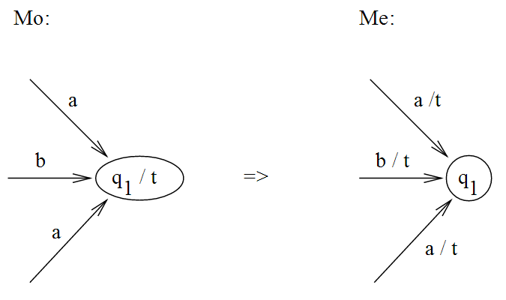

Machines with Output
We have 2 kinds of FSMs that can produce output:
Moore Machine
Mealy Machine

Slide 42
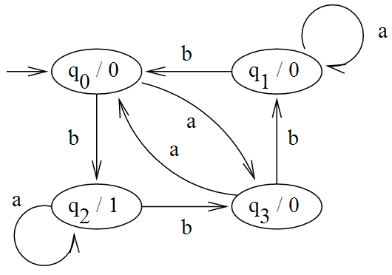
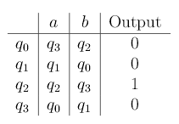



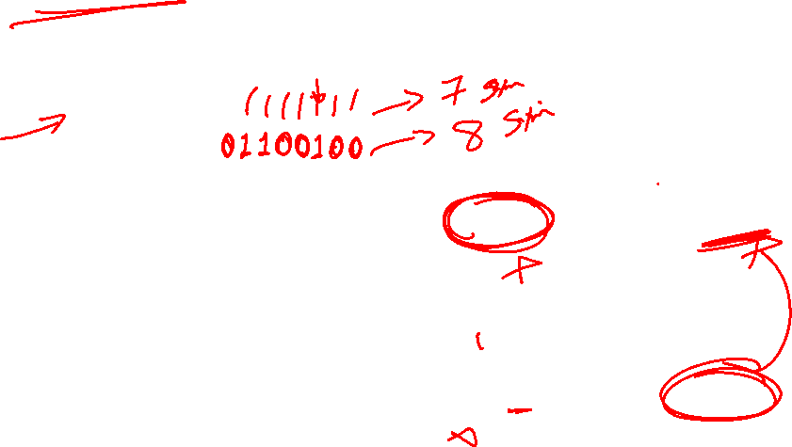



Moore Machine
Output is printed throughout states
On input = bababbb
Output = 01100100

Slide 43
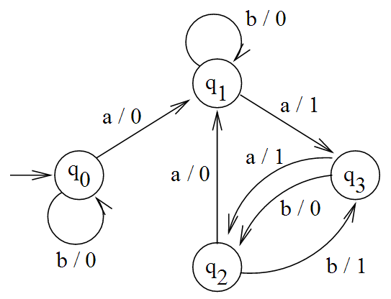

Mealy Machine
Output is printed throughout transitions
Input = bababbb
Output =

Slide 44
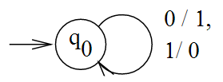
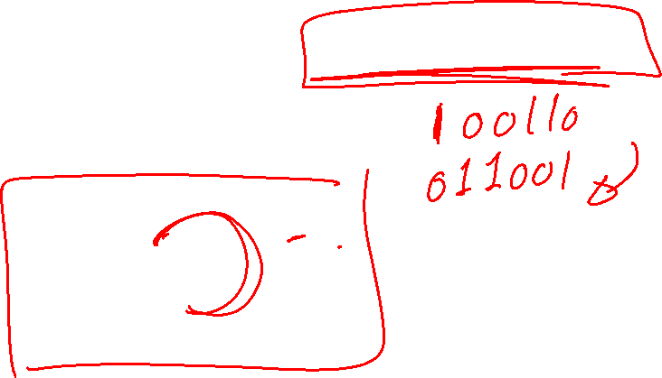
Mealy Machine printing the 1’s complement

Slide 45

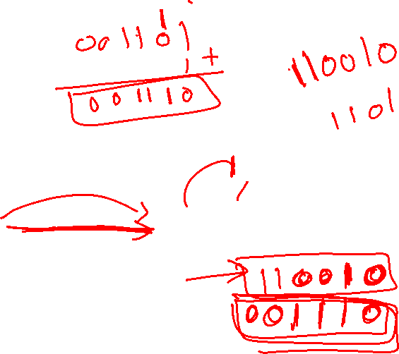
Mealy Machine printing the 2’s complement?

